Slide 1





TRAVEL INSURANCE
LET'S EXPLORE THE WORLD WITHOUT NO WORRIES!
Presented by: Mulya Fajar Ningsih Alwi - DTIDS

Slide 2


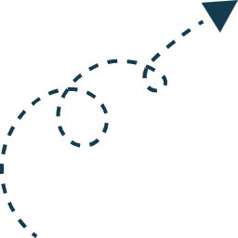
TOPIC OUTLINE
BUSINESS PROBLEM AND DATA UNDERSTANDING
DATA CLEANING
DATA ANALYSIS
FEATURE ENGINEERING
FEATURE SELECTION
MODELING AND EVALUATION
FEATURE IMPORTANCE
MODEL LIMITATION
COST EVALUATION
MODEL DEPLOYMENT
CONCLUSION
RECOMMENDATION

Slide 3




BUSINESS PROBLEM AND DATA UNDERSTANDING

Slide 4

CONTEXT
What is Travel Insurance?
Benefit of Travel Insurance?
Where Do Their Profits and Losses Come From?

Slide 5


PROBLEM STATEMENT
The company faces significant financial risk due to the inability to accurately predict claims.
Claim Status Proportion
Not Claim (0): 38,499 data points (98.29%)
Claim (1): 668 data points (1.71%)
Financial Data
Average policy cost: $524 per policy
Average insurance benefit coverage cost: $147,542 per policy
Potential Financial Loss Calculation
Revenue from non-claiming policyholders: 38,499 x $524 = $20,173,476
Revenue from claiming policyholders: 668 x $524 = $362,056
Total revenue: $20,535,532
Costs for claims: 668 x $147,542 = $98,558,056
Total potential financial loss: $20,535,532 - $98,558,056 = -$78,022,524

Slide 6

GOALS
Develop a predictive model to identify policyholders likely to file claims, enabling efficient fund allocation and minimizing financial losses.

Slide 7

ANALYTICAL APPROACH
Classification Models: Logistic Regression, K-Nearest Neighbors, and tree-based models like Decision Tree, Random Forest, AdaBoost, GradientBoost, and XGBoost
Resampling Methods: RandomOverSampler, SMOTE (Synthetic Minority Over-sampling Technique), RandomUnderSampler, and NearMiss

Slide 8
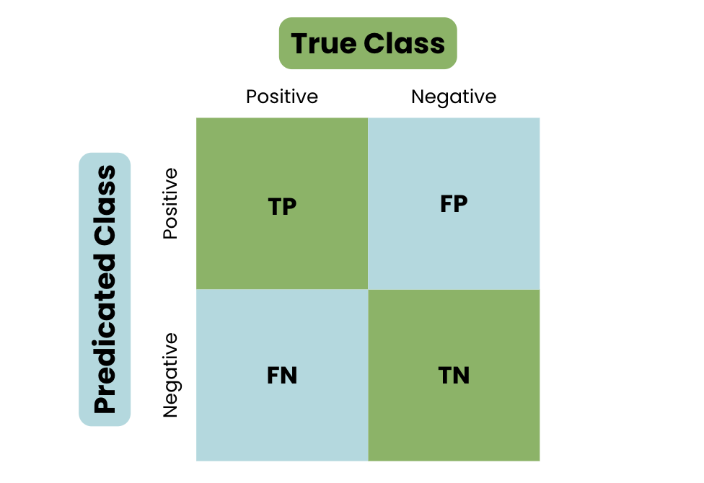



Idle Money
Lose investment opportunities
Evaluation Metrics
RECALL
Financial Losses
Impact Company's Reputation

Slide 9
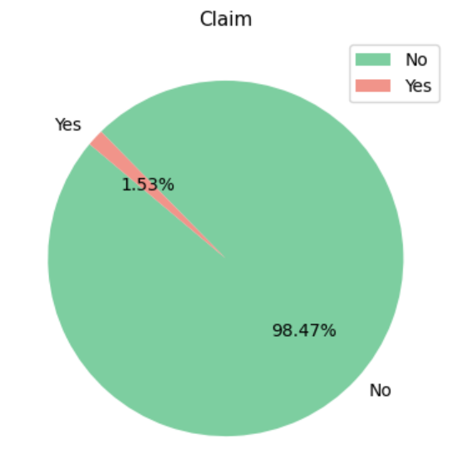
DATA UNDERSTANDING
Numerical features: Age, Commission, Net Sales, and Duration
Categorical features: Agency, Agency Type, Distribution Channel, Product Name, Gender, and Destination
Claim as a target variable

Slide 10
DATA PREPARATION

Slide 11



DATA CLEANING
MISSING VALUES
DATA DUPLICATE
Gender : 71.39%
Filled the Missing Values
Duplicate : 10.53%
Drop Duplicates Data
INVALID DATA
OUTLIERS
Duration : -1
Replace Invalid Data
Duration : > 540 days
Age : > 100 years old
Drop Only Extreme Values

Slide 12
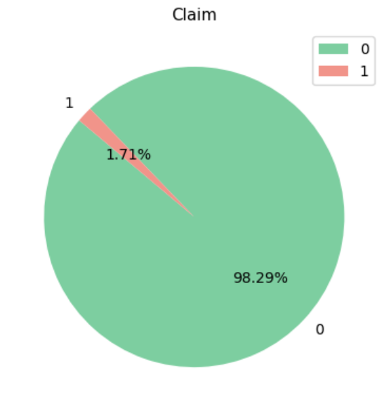
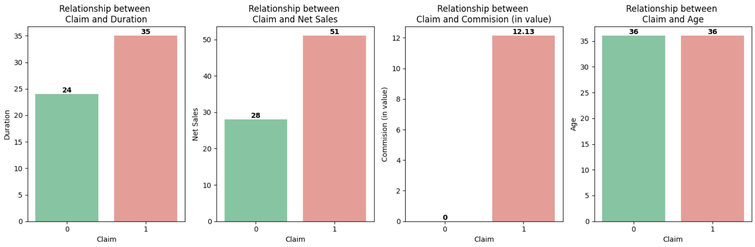
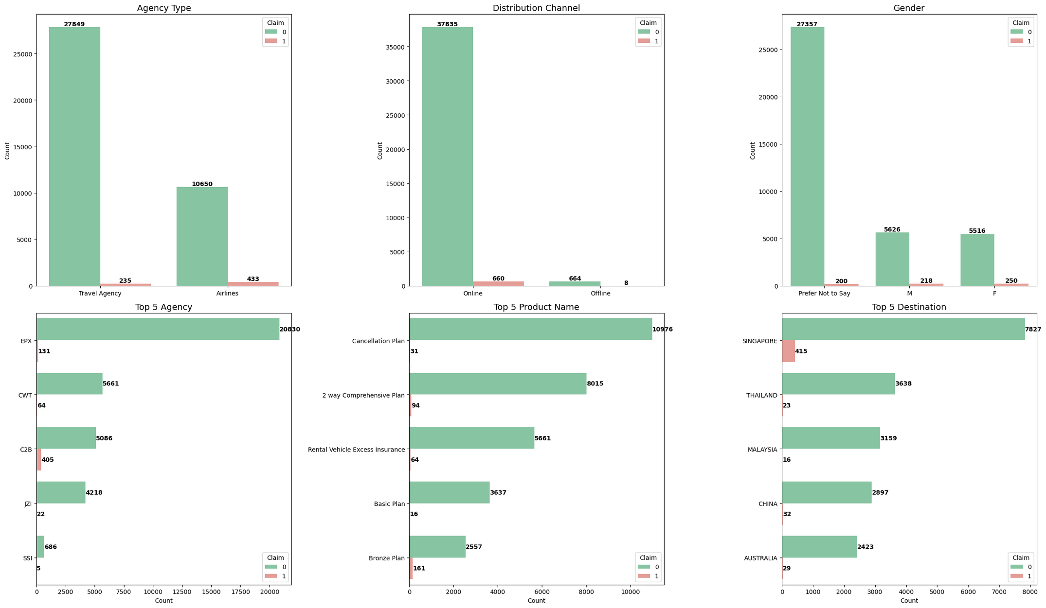

DATA ANALYSIS
Numerical Features Vs Target
Categorical Features Vs Target
Target Data Proportion After Cleaning

Slide 13


FEATURE ENGINEERING
DATA SPLITTING
ENCODING
Stratified Random Sampling
Split to Train and Test Set
One Hot Encoding
Binary Encoding
FEATURE SELECTION
RFE
Reduced from 25 to Only 13 Features
FEATURE SCALING
RESAMPLING
Robust Scaler
Only Applied to LogReg and KNN
ROS
RUS
SMOTE
NMISS

Slide 14

MODELING AND EVALUATION

Slide 15








MODELING AND EVALUATION FLOW
Best Model Based On Benchmark Performance
Hyperparameter Tuning for Best Model
Best 5 Models Based On Cross Validation
Models
Benchmark on Train and Test Set
Best Model Performance Comparison
Models
Cross Validation
Before Tuning
Without FS
With FS
Final Model
(XGBoost Without Feature Selection After Tuning)
After Tuning

Slide 16
FEATURE IMPORTANCE

Slide 17
Feature | Importance Mean | Importance Std
Commision (in value) | 0.012420 | 0.001094
Agency | 0.010148 | 0.001079
Net Sales | 0.006842 | 0.001382
Product Name | 0.005131 | 0.001005
Duration | 0.003651 | 0.001205
Gender | 0.000357 | 0.000395
Age | 0.000140 | 0.001269
Agency Type | 0.000000 | 0.000000
Distribution Channel | 0.000000 | 0.000000
Destination | -0.002144 | 0.001156
Most Influential Features:
Commission (in value)
Agency
Less Important Features:
Net Sales
Product Name
Duration
Low Impact:
Agency Type
Distribution Channel
Negative Impact:
Destination

Slide 18

MODEL LIMITATIONS

Slide 19

High Rate of False Positives
Need for Additional Data
Insufficient Features
The model is only valid for predictions within these ranges:
Age: 0 to 88 years
Net Sales: -357.5 to 682.0 dollars
Duration: 0 to 540 days
Commission: 0.0 to 262.76 dollars
Model Optimization

Slide 20


COST EVALUATION

Slide 21
Financial Data
Average policy cost: $524 per policy
Average insurance benefit coverage cost: $147,542 per policy
Cost Evaluation Without Model Total Policyholders: 7,834 Claims: 134 Premium Revenue from Claims: $70,216 Claims Costs: $19,770,628 Potential Financial Loss: $19,700,412 | Cost Evaluation With Model True Positives (TP): 126 Financial Savings: $18,524,268 False Negatives (FN): 8 Financial Loss: $1,176,144
Summary
Without Model (Total Potential Financial Loss): $19,700,412
With Model (Total Potential Financial Saved): $18,524,268
Percentage of Loss Saved: ($18,524,268 / $19,700,412) x 100 % = 94 %
Potential Financial Loss With Model: $1,176,144

Slide 22

MODEL DEPLOYMENT ON GOOGLE CLOUD

Slide 23
CONCLUSION AND RECOMMENDATION

Slide 24

CONCLUSION
Model Performance
The predictive model successfully minimizes false negatives but shows a high rate of false positives.
Financial Impact:
Without Model: Potential financial loss of $19,700,412.
With Model: Savings of $18,524,268, reducing potential financial loss by approximately 94%.

Slide 25
BUSINESS RECOMMENDATION
High-Risk Policyholders:
Implement stricter underwriting and higher premiums
Enhance monitoring and fraud detection
Offer risk management resources and deductible options
MODEL RECOMMENDATION
Low-Risk Policyholders:
Offer discounts and loyalty programs
Streamline claims process and provide additional benefits
Enhance digital engagement and offer bundled products
Address Data Imbalance
Enhance Features
Tune Model and Hyperparameters
Apply Advanced Resampling Techniques
Monitor and Maintain Model

Slide 26
THANK YOU!

Slide 27

Model | Sampling | Metric | Mean Score | Std Deviation | Feature Selection
XGBClassifier | NMISS | Recall | 0.868912 | 0.022898 | Without FS
XGBClassifier | NMISS | Recall | 0.859531 | 0.029648 | With FS
RandomForestClassifier | NMISS | Recall | 0.838988 | 0.030768 | Without FS
GradientBoostingClassifier | NMISS | Recall | 0.837083 | 0.032129 | Without FS
RandomForestClassifier | NMISS | Recall | 0.831494 | 0.031670 | With FS

Slide 28
model without feature selection | recall score (train set) | recall score (test set) | recall score (val set mean) | recall score (val set std)
GradientBoostingClassifier | 0.833333 | 0.813433 | 0.837083 | 0.032129
XGBClassifier | 0.906367 | 0.805970 | 0.868912 | 0.022898
RandomForestClassifier | 0.964419 | 0.798507 | 0.838988 | 0.030768
DecisionTreeClassifier | 0.960674 | 0.776119 | 0.831511 | 0.03811
AdaBoostClassifier | 0.803371 | 0.761194 | 0.803439 | 0.038474
KNeighborsClassifier | 0.735955 | 0.738806 | 0.726856 | 0.081346
LogisticRegression | 0.711610 | 0.701493 | 0.732393 | 0.055073

Slide 29
model with feature selection | recall score (train set) | recall score (test set) | recall score (val set mean) | recall score (val set std)
XGBClassifier | 0.921348 | 0.828358 | 0.859531 | 0.029648
DecisionTreeClassifier | 0.962547 | 0.820896 | 0.823982 | 0.019848
GradientBoostingClassifier | 0.837079 | 0.791045 | 0.833345 | 0.035109
RandomForestClassifier | 0.964419 | 0.783582 | 0.831494 | 0.031670
AdaBoostClassifier | 0.805243 | 0.783582 | 0.809046 | 0.040117
KNeighborsClassifier | 0.735955 | 0.738806 | 0.706225 | 0.069521
LogisticRegression | 0.668539 | 0.634328 | 0.681837 | 0.061322

Slide 30
Best Model: XGBClassifier without Feature Selection
Recall Performance:
Train Set Recall: 0.906
Test Set Recall: 0.806
Validation Set Recall: Mean 0.869, Standard Deviation 0.023
Stability: More stable than the model with feature selection, showing consistent performance across train, test, and validation sets.

Slide 31
Hyperparameter Tuning Using GridSearchCV to find the best hyperparameters. Here’s a simple overview of each parameter tested:
n_estimators: Number of trees in the model. Testing values: 100 and 200.
max_depth: Maximum depth of each tree. Testing values: 3 and 5.
learning_rate: Controls how much each tree contributes to the model. Testing values: 0.05 and 0.1.
subsample: Fraction of data used for each tree. Testing values: 0.8 and 1.0.
colsample_bytree: Fraction of features used for each tree. Testing values: 0.6 and 0.8.
min_child_weight: Minimum weight for a child node. Testing values: 1 and 3.
scale_pos_weight: Adjusts balance for imbalanced data. Testing values: 3 and 5.

Slide 32
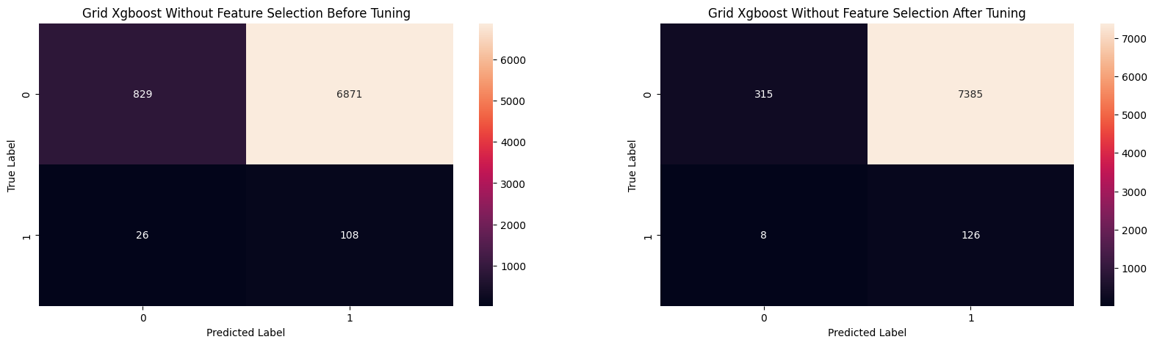
Before Tuning:
- Train Set Recall: 0.906
- Test Set Recall: 0.806

Slide 33
After Tuning:
- Train Set Recall: 0.957
- Test Set Recall: 0.940

Slide 34
Final Model: XGBoost Classifier (XGBClassifier)
Feature Selection: Not applied
Optimization: Hyperparameter tuning
Overview:
Type: XGBoost Classifier
Trees: 100
Tree Depth: 3
Learning Rate: 0.05
Feature Sampling: 60%
Data Sampling: 100%
Imbalance Adjustment: Class weights
How It Works:
XGBoost uses multiple decision trees to improve accuracy. Each tree corrects errors from the previous ones, making the model better at predicting claims.
Performance:
High Recall: Effectively identifies most claims.
Focus: Minimizes false negatives (correctly identifies actual claims) but may have more false positives.

